Slide 1


Green Pace
Security Policy Presentation
Developer: Els, Nicholas

Slide 2

OVERVIEW: DEFENSE IN DEPTH

Slide 3
THREATS MATRIX
Likely A threat is likely to occur | Priority A threat is very likely to occur
Low priority A threat is likely to occur but is less than a likely threat | Unlikely A threat is unlikely to occur

Slide 4
10 PRINCIPLES
Validate Input data
Heed compiler warnings
Architect and Design for Security Policies
Keep It Simple
Default Deny
Adhere to the Principle of Least Privilege
Sanitize Data Sent to Other Systems
Practice Defense in Depth
Use Effective Quality Assurance Techniques
Adopt a Secure Coding Standard

Slide 5
CODING STANDARDS
Data Type
Data Value
String Correctness
SQL Injection
Memory Protection
Assertions
Exceptions
Naming Convention of Files
Class protection
No wasted code

Slide 6
ENCRYPTION POLICIES
Flight
Rest
In use

Slide 7
TRIPLE-A POLICIES
Authentication
Authorization
Accounting

Slide 8
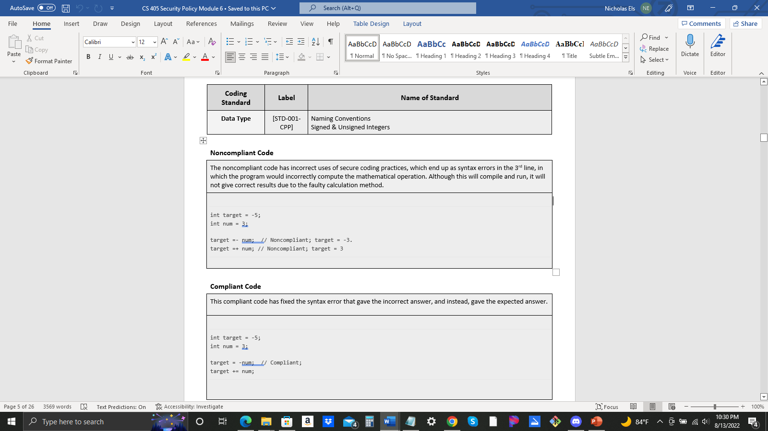
Unit Testing

Slide 9
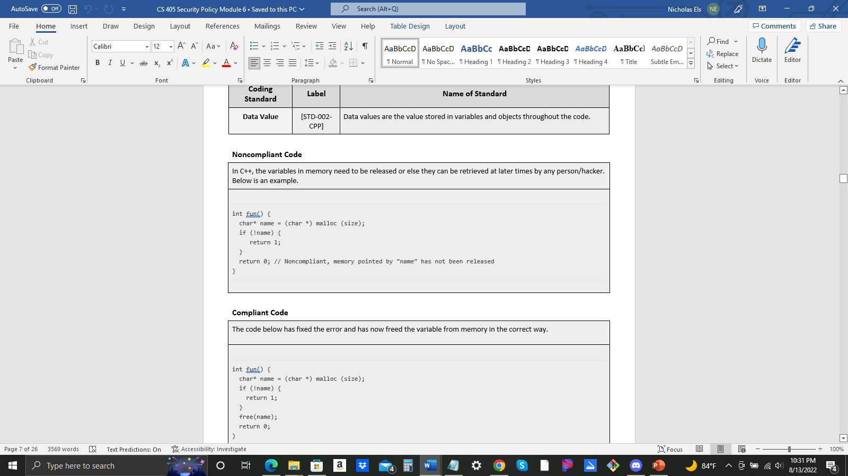
Unit Testing

Slide 10
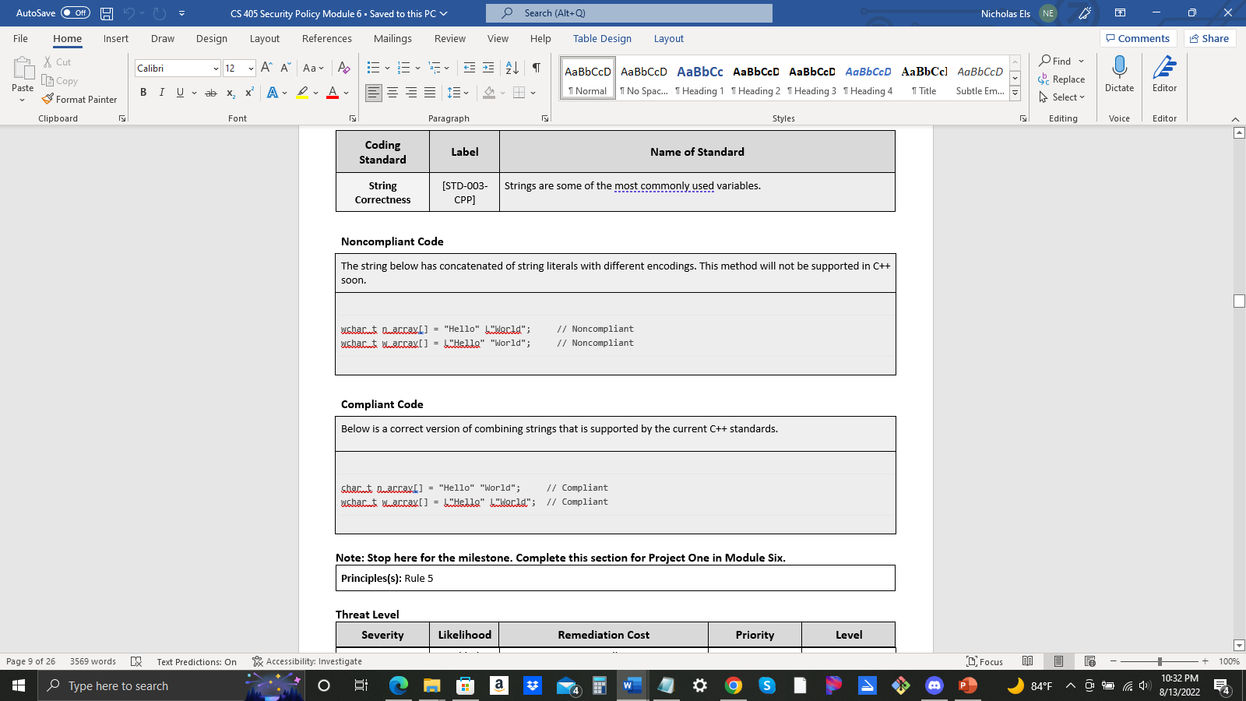
Unit Testing

Slide 11
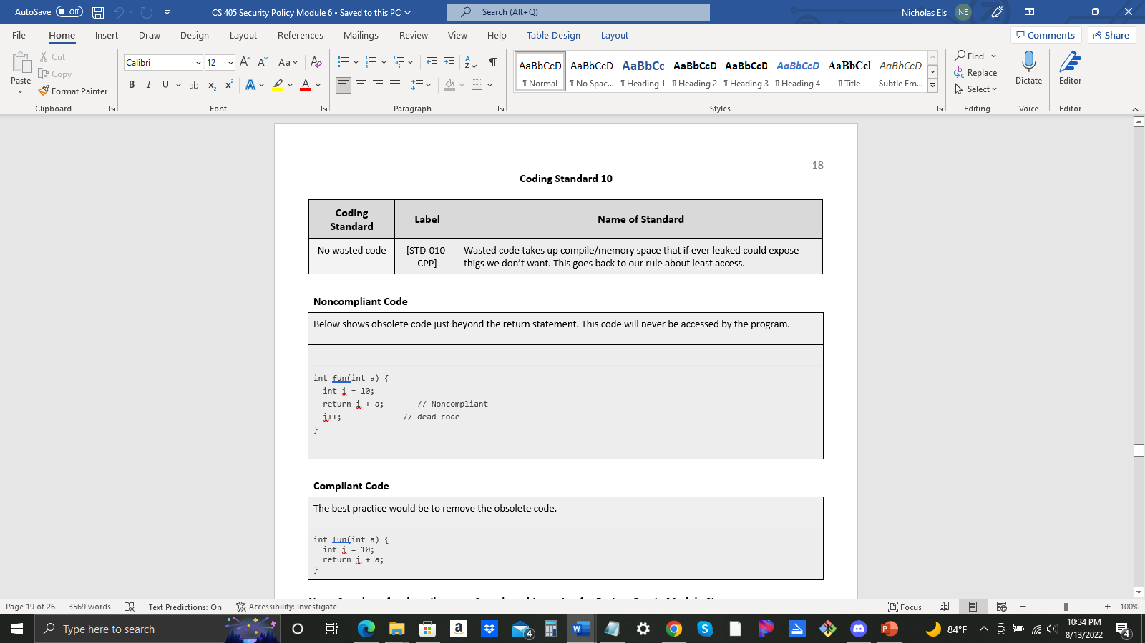
Unit Testing

Slide 12

AUTOMATION SUMMARY

Slide 13
TOOLS
SonarQube
Many, Many, More

Slide 14
RISKS AND BENEFITS
Always move forward
Never look back

Slide 15
RECOMMENDATIONS
There will always be gaps, your job is to find them.

Slide 16
CONCLUSIONS
ALL STANDARDS SHOULD BE ADOPTED!

Slide 17
REFERENCES
Defense-in-depth: Foundations for secure and Resilient Enterprises. (n.d.). Retrieved August 14, 2022, from https://resources.sei.cmu.edu/asset_files/Handbook/2006_002_001_14633.pdf

